Slide 1
Simplify AI Infrastructure with Kubernetes Operators
Ganeshkumar Ashokavardhanan, Microsoft Tariq Ibrahim, NVIDIA

Slide 2


About us
Ganeshkumar Ashokavardhanan
Microsoft: Azure Kubernetes Service
Tariq Ibrahim
NVIDIA: Cloud Native Technologies

Slide 3
Outline
Why Kubernetes (k8s) for AI/ML workloads
Layers of ML deployment stack
GPU management:
Overview and challenges
Intro to Kubernetes Operators
Why use Operators for GPU management
GPU operator design and details
ML application layer:
LLM fine-tuning demo: application-level operator + GPU operator

Slide 4
Why K8s for AI/ML?
Scalability: Scale resources up and down on-demand
Fault tolerance: High availability design. Self-Healing capabilities
Extensibility: Extend the K8s API through Custom Resource Definitions (CRD)
Ecosystem: A rich (and growing) set of applications and operators for AI/ML use-cases
Notes:
Scalability: Kubernetes allows users to scale ML workloads up or down, depending on demand. This ensures that machine learning pipelines can accommodate large-scale processing and training without interfering with other elements of the project.
Efficiency: Kubernetes optimizes resource allocation by scheduling workloads onto nodes based on their availability and capacity. By ensuring that computing resources are being utilized with intention, users can expect a reduction in cost and an increase in performance. Fault tolerance: With built-in fault tolerance and self-healing capabilities, users can trust Kubernetes to keep ML pipelines running even in the event of a hardware or software failure.
Explain the strengths of Kubernetes. Kubernetes is popular and reached the levels of adoption because of its API Kubernetes provides a Declarative configuration management. Uses controllers to make sure the desired state is always reflected in the current state. How to make most of Kubernetes? We Extend the API. Operators are an established pattern to extend the K8s API. Through the use of controllers and the Custom Resources, we apply the same principles of Kubernetes when solving domain specific problems

Slide 5
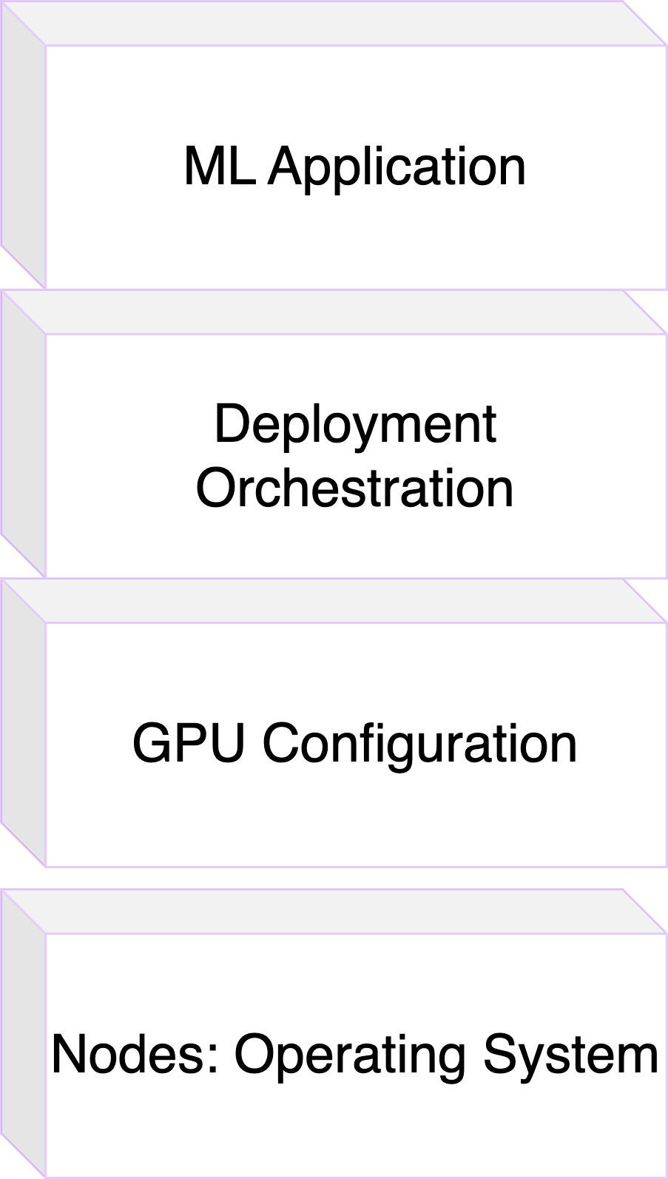
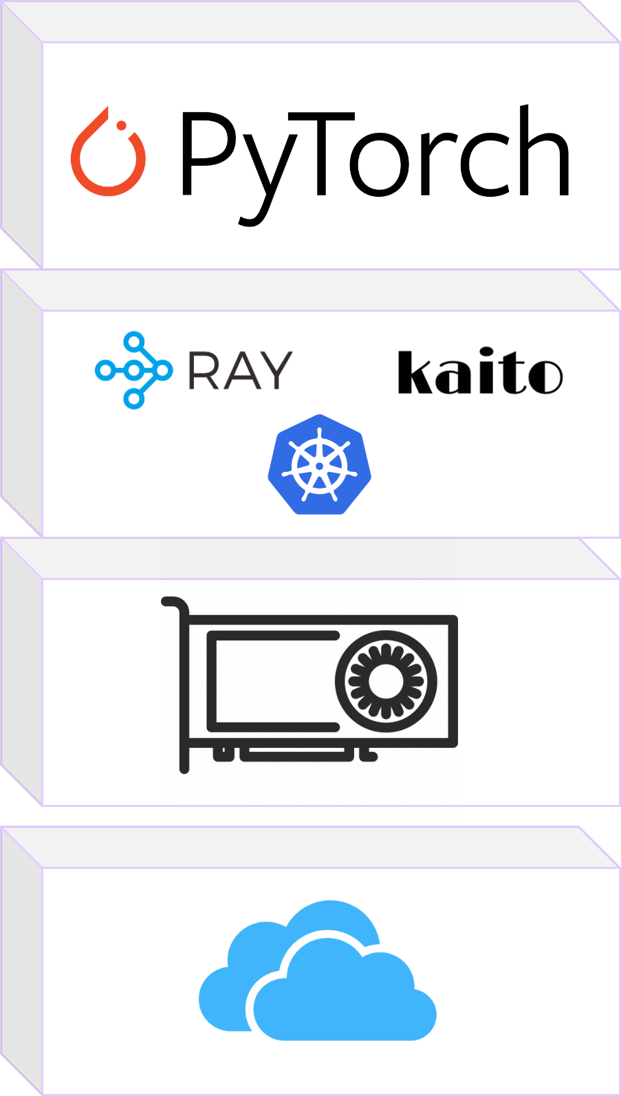
Layers of ML Deployment Stack

Slide 6
GPU Management in Kubernetes

Slide 7
Enabling GPU Support in Kubernetes Today
Install the GPU Device Driver
GPU Device Driver
T4
V100
Operating System
GPU Node

Slide 8



Enabling GPU Support in Kubernetes Today
Install the NVIDIA Container Toolkit
Configure container runtimes to access GPUs from within containers
Runtime Handlers for GPUs
Container Runtime
GPU Device Driver
T4
V100
Operating System
GPU Node

Slide 9

Enabling GPU Support in Kubernetes Today
Deploy the Device Plugin
Advertise GPUs to the kubelet
K8s Device Plugin
Runtime Handlers for GPUs
Container Runtime
GPU Device Driver
T4
V100
Operating System
GPU Node

Slide 10
Enabling GPU Support in Kubernetes Today
Deploy the Device Plugin
Advertise GPUs to the kubelet
K8s Device Plugin
$ kubectl describe node <node>
Name: <node>
Labels: <...>
<...>
Capacity:
cpu: 40
ephemeral-storage: 922257324Ki
nvidia.com/gpu: 8
memory: 65487504Ki
Allocatable:
cpu: 40
ephemeral-storage: 849952348392
nvidia.com/gpu: 8
memory: 65385104Ki
Runtime Handlers for GPUs
Container Runtime
GPU Device Driver
T4
V100
Operating System
GPU Node
Notes:
Todo: describe node output for delay device plugin

Slide 11
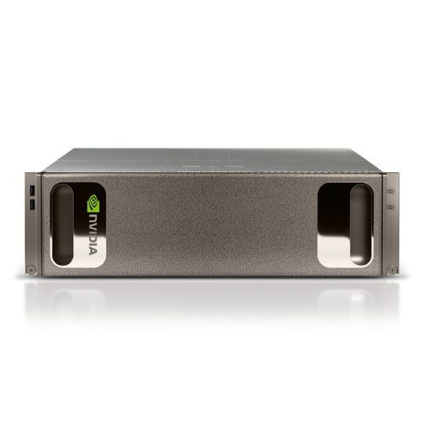



Enabling GPU Support in Kubernetes Today
Step 1: Use Machine Images or Provisioning Scripts to install host level components
Host-level Components nvidia-container-toolkit nvidia-gpu-driver
Machine Image
GPU Machines
T4
V100
Notes:
Package as a VM image or install during provisioning – what most users of AKS do now. AKS manages driver configuration. Similar experience in other clouds.

Slide 12



Enabling GPU Support in Kubernetes Today
Step 2: Deploy via yaml manifests/Helm Charts
Kubernetes Components
k8s-device-plugin
gpu-feature-discovery
nvidia-mig-manager
dcgm-exporter
....
T4
V100
Kubernetes Cluster
Notes:
User typically deploys

Slide 13
Enabling GPUs in Kubernetes
Install Drivers and Toolkit via Machine image
Advantages:
Machine Images are a well-supported deployment pattern
On-prem: Machine Images can be built with tools like Ansible, Chef or Packer
Cloud providers like Azure, AWS & GCP provide public OS Images for GPU Nodes
e.g. AKS-GPU repo
GPU configuration and testing are done by infra provider (cloud or on-prem)

Slide 14
Enabling GPUs in Kubernetes
Install Drivers and Toolkit via Machine image
Challenges:
Default version provided by the cloud provider can be hard to change
GPU driver and toolkit upgrades require node replacements or re-imaging
Node upgrades in K8s clusters can be slow, and sometimes disruptive
Separate machine images need to be maintained for CPU and GPU Nodes
Notes:
Managing compatibility matrix -> addressed through well-tested defaults through GPU operator
Allows for customization for advanced use-cases
Upgrades ->
Transition to Tariq here

Slide 15
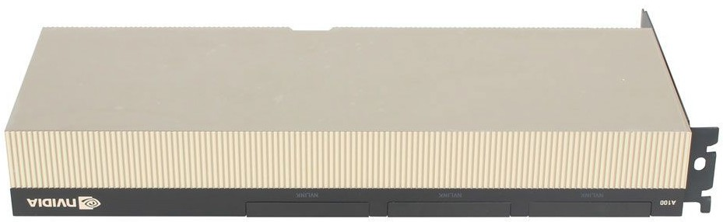
Operational Challenges
Day 2 Operations
Heterogeneous GPU SW Stack
Interoperability challenges
Component versions and configurations are constantly evolving
Node A
Node B
Node C
K8s Stack
K8s Stack
K8s Stack
GPU SW Stack
GPU SW Stack
GPU SW Stack
Container Runtime
Container Runtime
Container Runtime
OS
OS
OS
GPU Node
GPU Node
GPU Node
Notes:
Thank you Ganesh! I’ll be going into more detail on the Day 2 challenges (reconfiguration, upgrade, backup, failover, recovery, etc.) of managing GPUs on Kubernetes As we add more nodes to the k8s cluster and set them up for GPU support, we inevitably end up a with an inconsistent GPU SW Stack with different versions of toolkit and the driver applied across the cluster.. This becomes challenging to maintain over time as Cluster admins have to deal with every node on an individual basis. Moreover, the versions of these components are constantly changing and updates become a necessity very soon. We also need to ensure that the right sets of versions are used. At large scales, this becomes intractable and very error prone.

Slide 16
Operational Challenges
Day 2 Operations
GPU Driver Upgrades
Ensure No Running GPU Workloads
Disable GPU K8s Components
Unload Driver Modules
Cordon Node
Install new GPU Driver
GPU Node
Ready
Uncordon Node
Re-enable GPU K8s Components
Notes:
Now let’s look closely at the GPU Driver Upgrade process. These are the steps to follow to ensure a error-free upgrade process. (Go over the flow chart briefly)
Zero downtime upgrades are critical
Upgrades are disruptive
No workloads can run during upgrades
Control parallelism of driver upgrades in the cluster

Slide 17
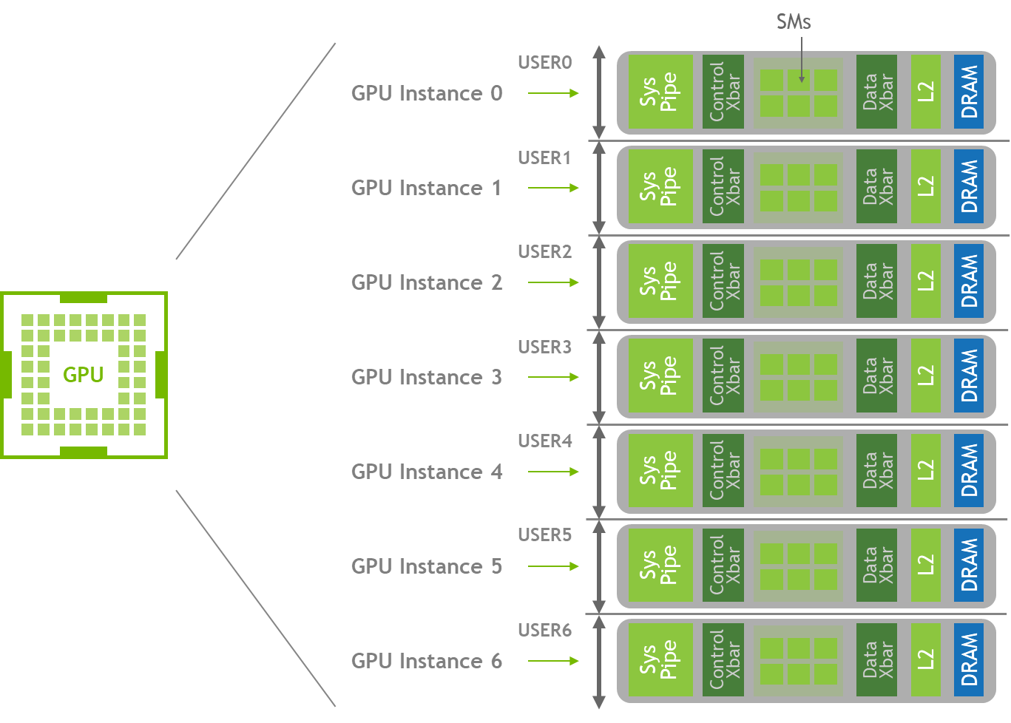
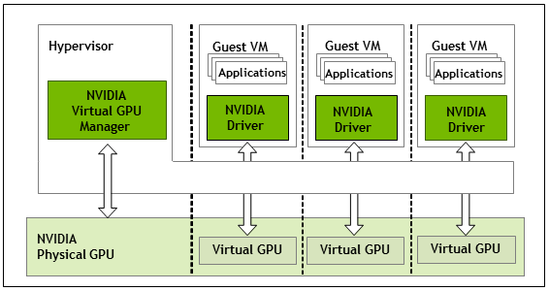
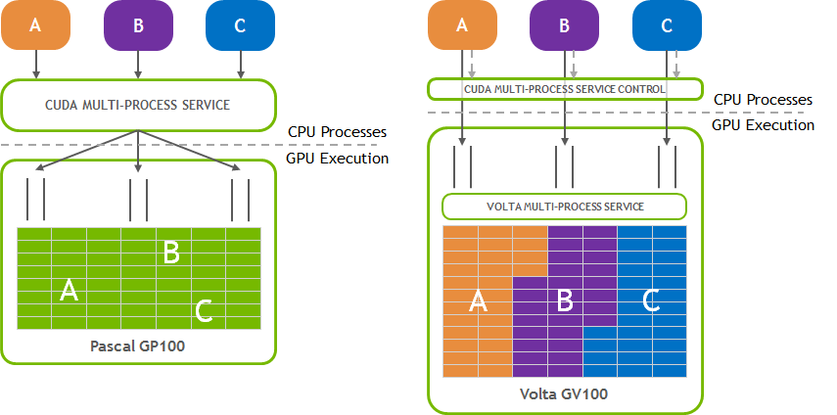
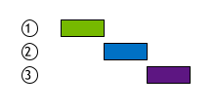
Operational Challenges
Node-level configuration
MIG and Time sharing configurations are usually applied on a per-node basis
It is common to enable timesharing on some nodes
The timesharing configs need to persist during driver upgrades or node reboots
Multi-Instance GPUs (MIG)*
vGPU
Time Slicing
Multi-Process Service (MPS)
* Only supported on MIG-capable GPUs like
A30, A100, H100, H200
Notes:
Next, we talk about the challenges of maintaining and persisting configurations that are applied on a per-node basis. As an example, it is common to apply GPU sharing configurations like MIG mode, timeslicing or vGPUs on certain nodes..During the day 2 operations on the gpu software stack, Cluster would admins would have to ensure the node-level configurations are also restored after an update/upgrade or a node reboot

Slide 18


Operational Challenges
GPU Monitoring & Observability
Collect health, diagnostics and usage data
Integrate GPU monitoring into cloud native systems like Prometheus
Alerting on unhealthy GPUs
GPU 0
GPU 2
GPU 3
Prometheus
Kubelet
API Server
Service monitor
DCGM-exporter
HTTP
server
Metrics
Collector
DCGM
node-exporter

Slide 19
Kubernetes Operators
Notes:
As we just have seen, there is a lot of operational overhead when it comes to Managing GPUs at scale in Kubernetes.One way to address this challenge is for Cluster admins to write automation scripts to codify this operational knowledge. But what if we leveraged the power of Kubernetes to solve this problem? Kubernetes Operators are used for this exact purpose!

Slide 20

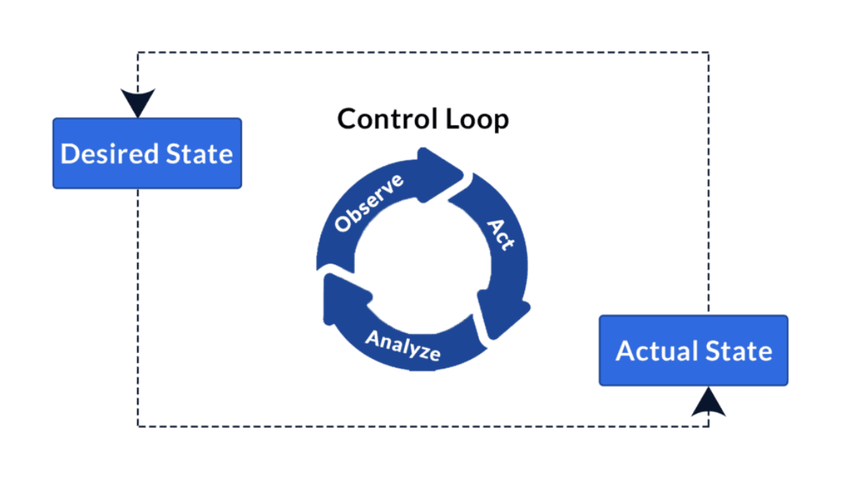
What are Kubernetes Operators ?
CoreOS definition
“An Operator is software that encodes this domain knowledge and extends the Kubernetes API through the third party resources (custom resources) mechanism, enabling users to create, configure, and manage applications.”
Operators are essentially made up of:
Custom Resources - Define desired configuration and states
Controllers - Manage state. Control loops which run the business logic to reconcile the current state with the desired state
Notes:
So, What are Kubernetes Operators? “Operators are nothing but software extensions that use custom resources to manage applications and their components“. In other words, Operators provide a pattern for developing Kubernetes applications and implementing the automation of Day 1 and Day 2 tasks

Slide 21
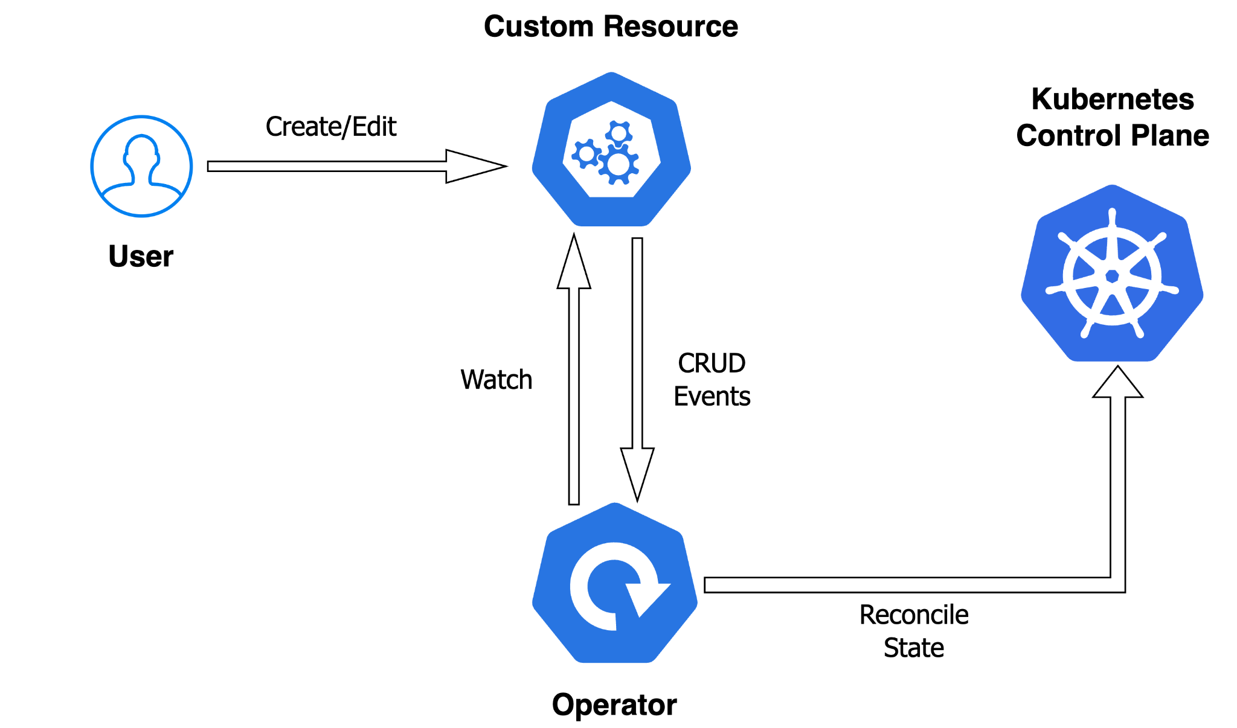
Kubernetes Operators
Notes:
Here is a diagram that provides a high-level overview of an Operator. Custom resources are a way for users to extend the Kubernetes API and express the desired state and configuration of the application in question. The controller runs in an infinite loop continuously monitoring changes to the custom resource, detecting any differences between the desired state and the live state and finally reconciling the state drift. The controller of the operator is what typically executes the business and operational logic needed to deploy and manage the lifecycle of the application.

Slide 22
Why use Operators ?
Extend the Kubernetes functionality to solve domain-specific problems
Standardize Operations and create a consistent approach to automation
Use Kubernetes to perform operations and tasks that are usually performed by other tools
Broad ecosystem of Operator frameworks and catalogs
Notes:
(Mention this): With Operators, you can use Kubernetes primitives as building blocks to solve more complex and domain specific problems

Slide 23
Kubernetes Operators
for AI/ML

Slide 24
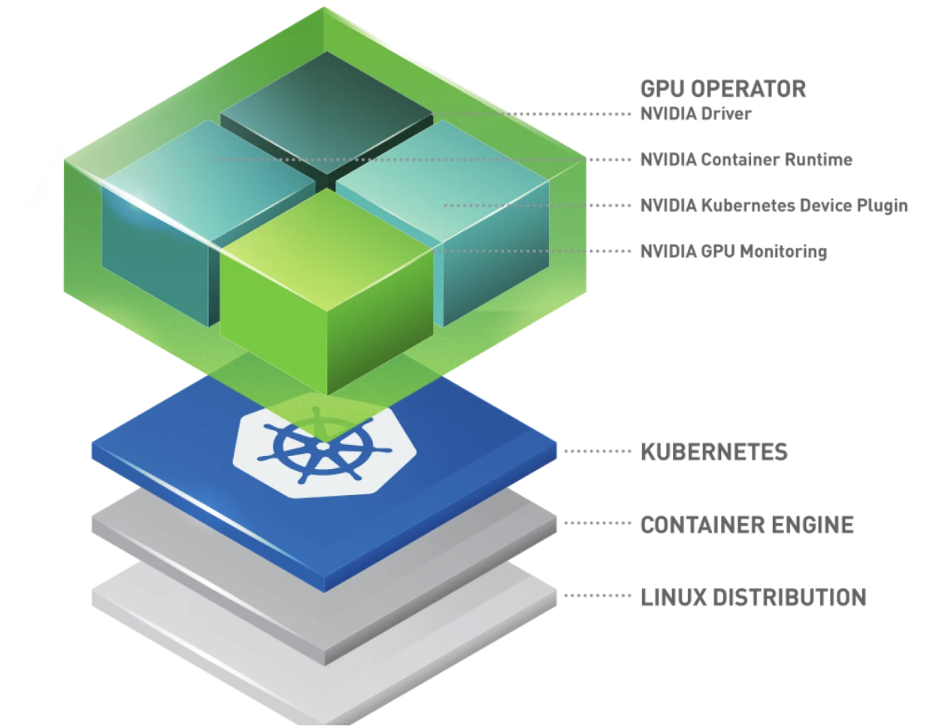
GPU Operator
https://github.com/NVIDIA/gpu-operator

Slide 25

GPU Operator
GPU Operator provides automation to install and manage the components needed for GPUs on Kubernetes
Without GPU Operator
With GPU Operator
Kubernetes Manifests/Helm
Device Plugin
NVIDIA GPU Operator
…..
DCGM Exporter
MIG manager
GPU Feature Discovery
Device Plugin
Container Toolkit
GPU Driver
Container Toolkit
Kubernetes Client
Container Toolkit
Pre-installed
via Machine Image
GPU Driver
Kubernetes
Kubernetes
Container Runtime
Container Runtime
Operating System
Operating System
GPU Server
GPU Server
Manage CPUs and GPUs in a single stack through management at the cluster level
and access extra functionalities and features

Slide 26


GPU Operator
Custom Resources
kubectl
create/apply/edit
ClusterPolicy
NVIDIADriver
Kubernetes Control Plane
User
Watch
CRUD
Events
ClusterPolicy
Controller
NVIDIADriver
Controller
Upgrade
Controller
Reconcile
State
GPU Operator
Notes:
Common API (ClusterPolicy) to configure and handle the lifecycle of the gpu software stack
ClusterPolicy API defines a spec to express state in terms of the GPU software components while abstracting out all of the YAML manifests needed to bring them up
Declarative. The ClusterPolicy has a controller that watches changes to the ClusterPolicy resource and reconcile the current state with the desired state

Slide 27
ClusterPolicy API
apiVersion: nvidia.com/v1
kind: ClusterPolicy
metadata:
name: cluster-policy
spec:
devicePlugin:
enabled: true
image: k8s-device-plugin
version: v0.16.2-ubi8
driver:
enabled: true
version: 550.90.07
migManager:
enabled: true
image: k8s-mig-manager
version: v0.8.0-ubuntu20.04
dcgmExporter:
enabled: true
image: k8s-mig-manager
version: v0.8.0-ubuntu20.04
......
status:
conditions:
message: “ClusterPolicy is ready as all resources have been successfully reconciled”
reason: Reconciled
status: "True"
type: Ready
state: ready

Slide 28
ClusterPolicy API
apiVersion: nvidia.com/v1
kind: ClusterPolicy
metadata:
name: cluster-policy
spec:
devicePlugin:
enabled: true
image: k8s-device-plugin
version: v0.16.2-ubi8
driver:
enabled: true
version: 550.90.07
migManager:
enabled: true
image: k8s-mig-manager
version: v0.8.0-ubuntu20.04
dcgmExporter:
enabled: true
image: k8s-mig-manager
version: v0.8.0-ubuntu20.04
......
status:
conditions:
message: “ClusterPolicy is ready as all resources have been successfully reconciled”
reason: Reconciled
status: "True"
type: Ready
state: ready
Express desired state of GPU software stack
Toggle components on/off
Set component versions
Set component configs

Slide 29
ClusterPolicy API
apiVersion: nvidia.com/v1
kind: ClusterPolicy
metadata:
name: cluster-policy
spec:
devicePlugin:
enabled: true
image: k8s-device-plugin
version: v0.16.2-ubi8
driver:
enabled: true
version: 550.90.07
migManager:
enabled: true
image: k8s-mig-manager
version: v0.8.0-ubuntu20.04
dcgmExporter:
enabled: true
image: k8s-mig-manager
version: v0.8.0-ubuntu20.04
......
status:
conditions:
message: “ClusterPolicy is ready as all resources have been successfully reconciled”
reason: Reconciled
status: "True"
type: Ready
state: ready
Get current status of the GPU Software Stack

Slide 30
NVIDIADriver API
A new API for managing GPU drivers
Ability to deploy multiple driver versions and/or driver versions on a single cluster
Supports different driver versions, OS versions, and driver types (vGPU vs non-vGPU)
apiVersion: nvidia.com/v1alpha1
kind: NVIDIADriver
metadata:
name: turing
spec:
driverType: gpu
nodeSelector:
node.kubernetes.io/instance-type: Standard_NC8as_T4_v3
version: 550.90.07
status:
conditions:
message: “All resources have been successfully reconciled”
reason: Reconciled
status: "True"
type: Ready
state: ready
apiVersion: nvidia.com/v1alpha1
kind: NVIDIADriver
metadata:
name: volta
spec:
driverType: gpu
nodeSelector:
node.kubernetes.io/instance-type: Standard_NC12s_v3
version: 535.183.06
status:
conditions:
message: “All resources have been successfully reconciled”
reason: Reconciled
status: "True"
type: Ready
state: ready

Slide 31
NVIDIADriver API
apiVersion: nvidia.com/v1alpha1
kind: NVIDIADriver
metadata:
name: turing
spec:
driverType: gpu
nodeSelector:
node.kubernetes.io/instance-type: Standard_NC8as_T4_v3
version: 550.90.07
status:
conditions:
message: “All resources have been successfully reconciled”
reason: Reconciled
status: "True"
type: Ready
state: ready
apiVersion: nvidia.com/v1alpha1
kind: NVIDIADriver
metadata:
name: volta
spec:
driverType: gpu
nodeSelector:
node.kubernetes.io/instance-type: Standard_NC12s_v3
version: 535.183.06
status:
conditions:
message: “All resources have been successfully reconciled”
reason: Reconciled
status: "True"
type: Ready
state: ready
Deploy R550 drivers on Nodes with T4 GPUs
Deploy R535 drivers on Nodes with V100 GPUs

Slide 32
GPU Driver Container
Containerized Driver Installation
root@nvidia-driver-daemonset$ lsmod | grep nvidia
nvidia_modeset 1306624 0
nvidia_uvm 1527808 0
nvidia 56741888 66 nvidia_uvm,nvidia_modeset
root@nvidia-driver-daemonset$ nvidia-smi
+---------------------------------------------------------------------------------------+
| NVIDIA-SMI 535.183.01 Driver Version: 535.183.01 CUDA Version: 12.2 |
|-----------------------------------------+----------------------+----------------------+
| GPU Name Persistence-M | Bus-Id Disp.A | Volatile Uncorr. ECC |
| Fan Temp Perf Pwr:Usage/Cap | Memory-Usage | GPU-Util Compute M. |
| | | MIG M. |
|=========================================+======================+======================|
| 0 Tesla T4 On | 00000001:00:00.0 Off | Off |
| N/A 37C P8 15W / 70W | 0MiB / 16384MiB | 0% Default |
| | | N/A |
+-----------------------------------------+----------------------+----------------------+
+---------------------------------------------------------------------------------------+
| Processes: |
| GPU GI CI PID Type Process name GPU Memory |
| ID ID Usage |
|=======================================================================================|
| No running processes found |
+---------------------------------------------------------------------------------------+
The NVIDIA GPU driver container provides few benefits over a standard driver installation:
Ease of deployment
Fast installation
Reproducibility
Notes:
The next few slides I will be highlighting some of the key components of the operator in more detail.
First with the Driver pod – which takes care of installing the NVIDIA driver in a container.
There are many benefits of the driver container, many which correspond to the benefits of containers in general.
We know that driver installs and upgrades are very error-prone and cumbersome
By wrapping up the install logic in a container, we provide very reproducible builds that are portable.
We can then exec into the driver pod and run nvidia-smi to query the GPU and lsmod to view the kernel modules loaded by the driver
In this example, the 535 Driver is installed on an NVIDIA T4 GPU.

Slide 33
MIG Manager
Securely partition MIG-Capable GPUs into separate GPU Instances
$ kubectl label nodes <node> nvidia.com/mig.config=all-1g.5gb --overwrite
$ kubectl describe node <node>
<SNIP>
Labels: <SNIP>
nvidia.com/gpu.product=NVIDIA-A100-PCIE-40GB-1g.5gb
<SNIP>
Allocatable:
<SNIP>
nvidia.com/gpu: 7
MIG with single strategy
$ kubectl label nodes <node> nvidia.com/mig.config=all-1g.5gb --overwrite
$ kubectl describe node <node>
<SNIP>
Labels: <SNIP>
nvidia.com/gpu.product=NVIDIA-A100-PCIE-40GB
<SNIP>
Allocatable:
<SNIP>
nvidia.com/gpu: 0
nvidia.com/mig-1g.5gb 7
nvidia.com/mig-2g.10gb 0
nvidia.com/mig-3g.20gb 0
MIG Manager automates enabling & configuring MIG on the GPU
Single vs. Mixed strategy for advertising MIG devices to Kubernetes
MIG with mixed strategy
Notes:
MIG stands for Multi-Instance GPU. This is currently supported in the A100, A30, H100 GPUs, that allows one to securely partition one physical GPU into separate GPU instances, what we call MIG devices.
I am not going to go into the details of MIG, but there are many ways you can slice your GPU.
For example you can have up to 7 slices that have a small amount of GPU compute resources and memory, or you can have less slices where each slice has more compute and memory resources.

Slide 34
GPU Feature Discovery
Expose GPU Details as labels
$ kubectl describe node <node>
Name: <node>
Labels: node.kubernetes.io/os=linux
node.kubernetes.io/instance-type=Standard_NC8as_T4_v3
<...>
nvidia.com/cuda.driver-version.full=535.183.01
nvidia.com/cuda.runtime-version.full=12.2
nvidia.com/gpu.family=turing
nvidia.com/gpu.machine=Virtual-Machine
nvidia.com/gpu.memory=16384
nvidia.com/gpu.mode=compute
nvidia.com/gpu.product=Tesla-T4
<...>
topology.disk.csi.azure.com/zone=
topology.kubernetes.io/region=southcentralus
topology.kubernetes.io/zone=0
<...>
<...>

Slide 35
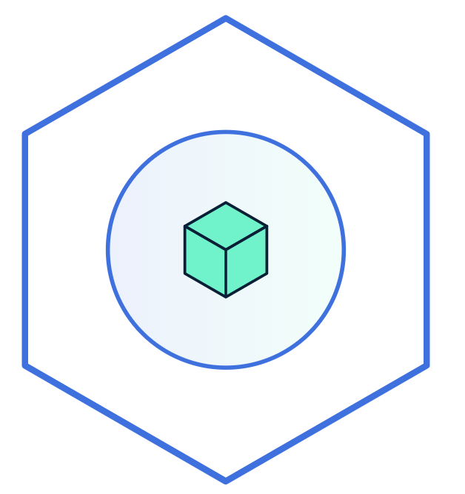
GPU Feature Discovery
Expose GPU Details as labels
apiVersion: v1
kind: Pod
metadata:
name: gpu-example
spec:
containers:
- name: gpu-example
image: nvidia/cuda
resources:
limits:
nvidia.com/gpu: 1
nodeSelector:
nvidia.com/gpu.product: A100-PCIE-40GB
nvidia.com/cuda.runtime: 12.2
nvidia.com/cuda.driver: 535.183.01
Server
Server
Server
2x NVIDIA T4
2x NVIDIA V100
2x NVIDIA A100
T4

Slide 36
GPU Operator In Action
Orchestrates all Components
ClusterPolicy
Custom Resources
GPU Operator
Controller
NVIDIADriver
Reconciliation
Node Feature Discovery
Installation
Kubernetes
Monitoring
NFD
GPU
Driver
Container Toolkit
Device
Plugin
GPU
Feature Discovery
MIG Manager
DCGM
DCGM Exporter
Label nodes
Node Ready
Validation
Validation

Slide 37
Fine-tuning LLMs with Operators
Notes:
Can be anything -

Slide 38
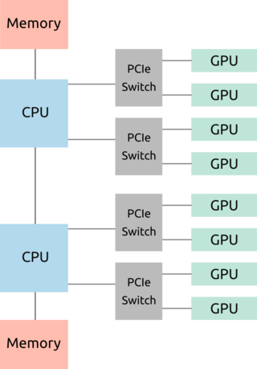


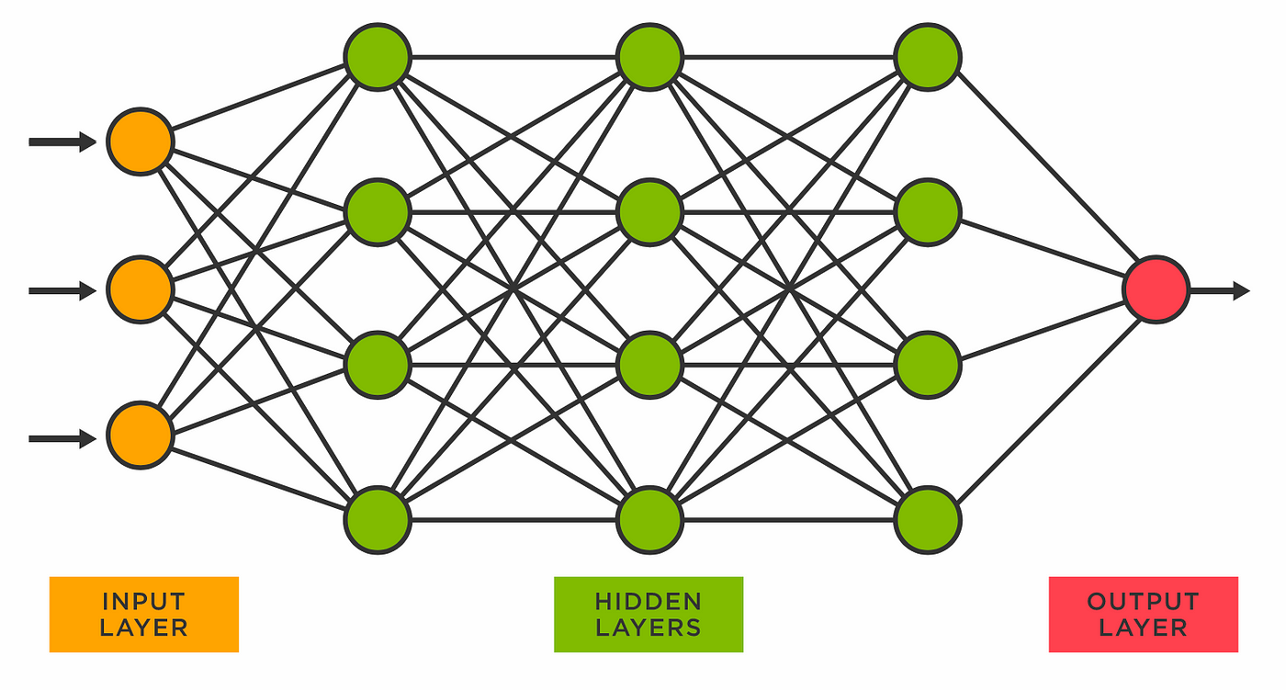
Fine-tuning Requirements
Pre-trained model
Dataset
Training loop
GPU config
Notes:
Foundational model (Llama, Phi, Falcon)
Data set to fine tune with
Enough GPU memory
Appropriate VM type
Multiple-GPU on same node
Multi-node distributed training:
Network set up
Env variables for addresses
Fine-tuning application code
Optional need: see GPU usage metrics for utilization, driver config

Slide 39



Open-source ML operators
kuberay
With ray for distributed training and compute
kserve
Model inference platform. Flexible and integrates with ecosystem
Kubernetes AI Toolchain Operator
Easy to use inference and fine-tuning with foundational models
Notes:
Kubeflow Training Operator
Ray
KAITO

Slide 40
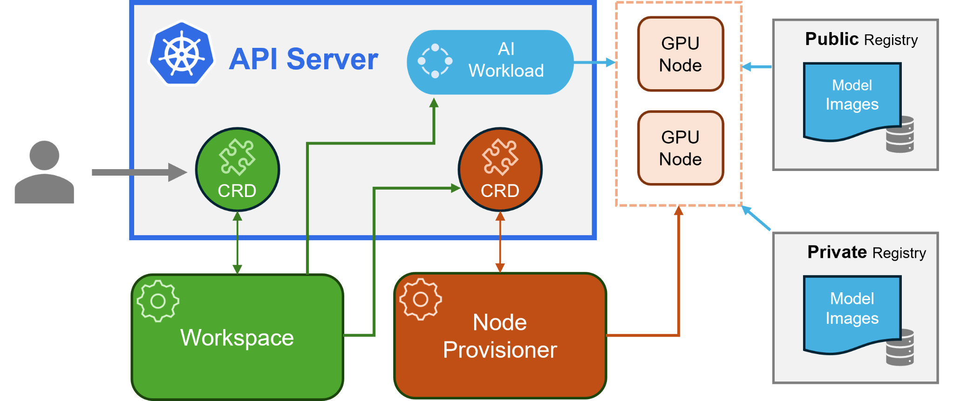
Kubernetes AI Toolchain Operator
Notes:
Workspace CRD to manage deployment and lifecycle of workloads
Optional CRD for node provisioning - not using today, as we are using AKS nodes and GPU operator to manage nodes
Pre-sets for common foundational models, like Phi-3 and Llama
Container images for foundational models, data set to fine-tune with can be specified

Slide 41
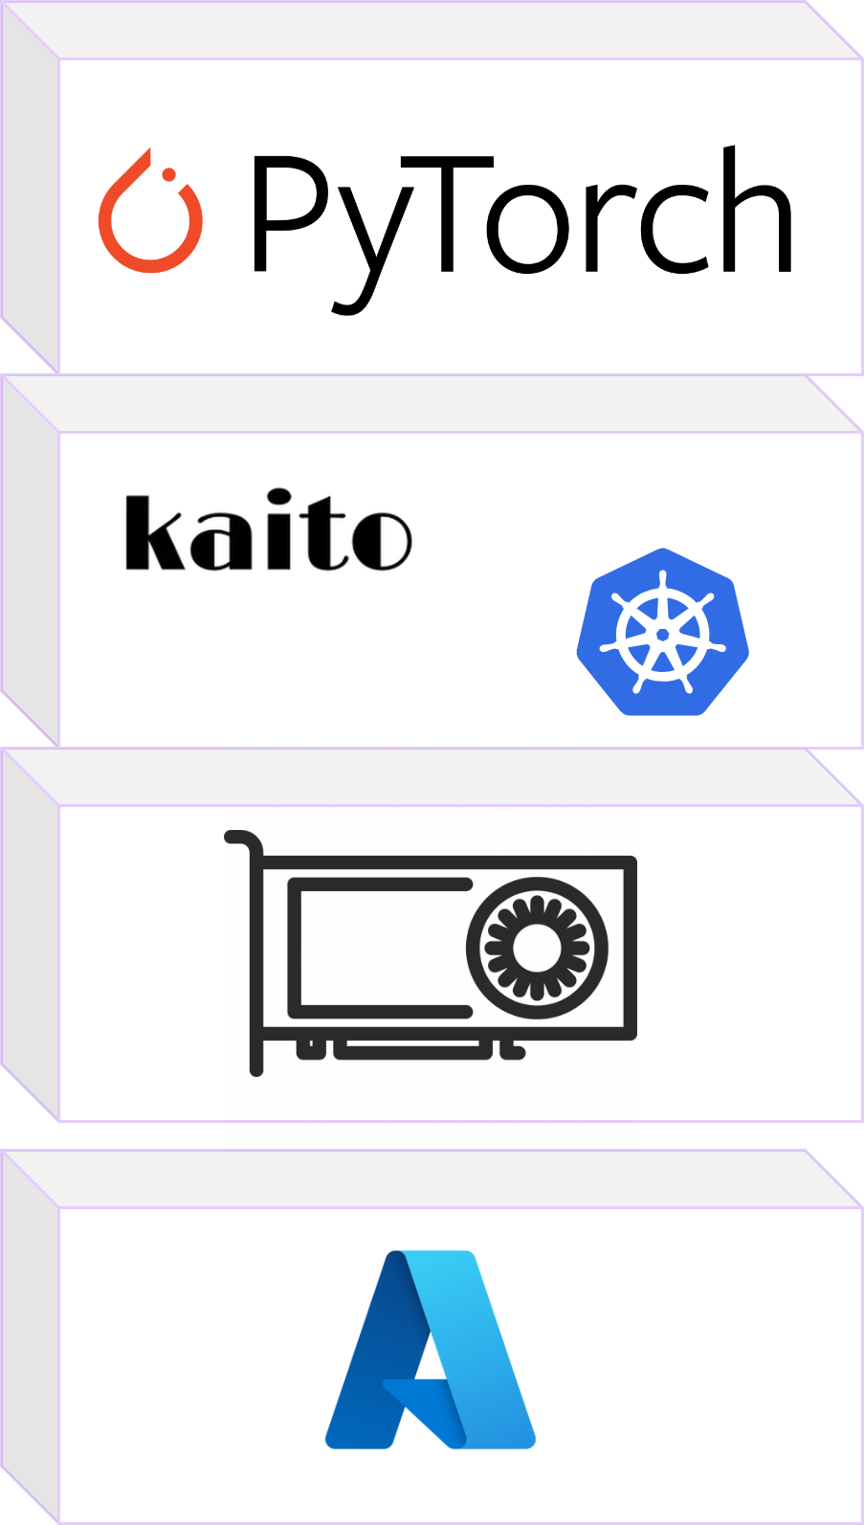
Overview of LLM Fine-tuning Demo
Notes:
Training loop with pytorch
Kaito

Slide 42
Demo with GPU-Operator and Fine-tuning with KAITO

Slide 43
Key Takeaways
For infra providers and cluster admins: challenging to manage GPU nodes and provide flexibility
K8s operators and how they simplify and automate
Automate GPU resource management through GPU operator
Use operators at the application-layer to simplify ML workload management
Simplify various layers of the ML deployment stack with operators
Notes:
– Operators as a standard pattern to automate processes through custom resources and controllers

Slide 44
Thank you

